Slide 1
Online Banking Management
Group members:
1.soumya ranjan parida-2201020282
2.Priyanshu sekhar bhuyan-2201020468
3.Sundeep nayak-2201020679
4.Prem keshari sahoo-2201020638
5.MD Ayaan-2201020312

Slide 2
Introduction
This presentation covers the components and implementation of an online banking management system, focusing on Java, MySQL, and JFrame.

Slide 3
01
System Overview

Slide 4
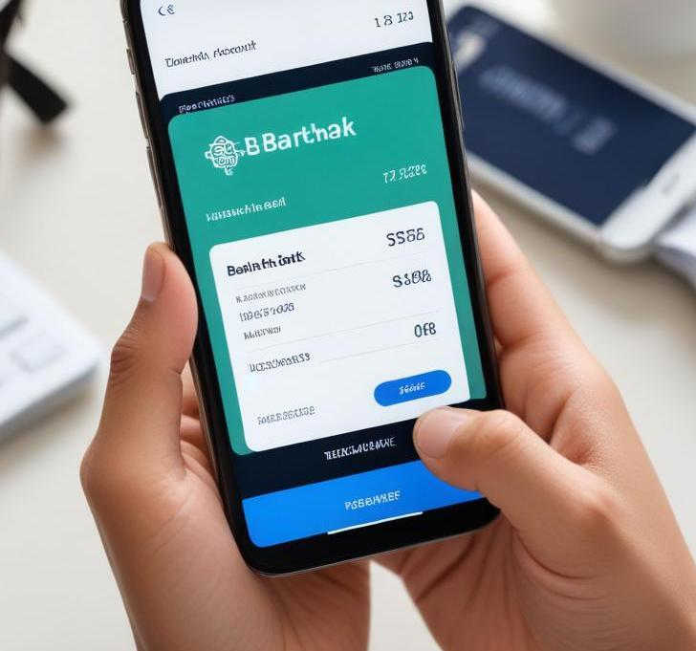
What is Online Banking?
Online banking allows customers to access their bank accounts and conduct financial transactions over the internet. Key capabilities include viewing account balances, transferring funds, and paying bills without needing to visit a physical bank branch.

Slide 5
Key Features of the System
The online banking management system includes user authentication, account management, transaction history, fund transfers, bill payments, and security measures such as encryption to protect user data.

Slide 6
Architecture of the System
The architecture of the online banking management system comprises a client-server model where clients access the application via a web interface. The server handles backend processes such as database management, transaction processing, and security protocols to ensure safe operations.

Slide 7
02
Technical Implementation

Slide 8

Java and MySQL Integration
The system utilizes Java as the programming language for backend logic and MySQL for data storage. JDBC (Java Database Connectivity) is employed to facilitate communication between the Java application and the MySQL database, allowing for seamless data retrieval and storage.

Slide 9
Using JFrame for GUI
JFrame is used to create a graphical user interface (GUI) for the online banking system. It provides windows, buttons, and other UI components that users interact with. The GUI is designed to be intuitive, making it easy for users to navigate through different banking functions.

Slide 10
Handling Transactions and Security
The online banking system ensures secure handling of transactions through encryption and secure connections (SSL/TLS). Each user session requires authentication, and sensitive operations, like fund transfers, undergo multiple verification steps to prevent unauthorized access.

Slide 11

Conclusions
The online banking management system in Java, utilizing MySQL and JFrame, presents an efficient and secure solution for users to manage their finances. Its architecture and technical implementation ensure scalability and reliability.

Slide 12
Thank you!
Do you have any questions?
Thank you!

